Slide 1

Angular Application
By: Munish Arora
Munish.arora@gmail.com

Slide 2
Introduction
In this, we will cover
Angular CLI
Setting Up Default Angular Application
Demo: First Project
Application Workflow and Application Structure
Single Page Application, Angular App, Components, Module
Demo: Creating Component Via CLI
Templates and Directives
Demo: Templates and Directives
Services and Dependency Injection
Demo: Services and Dependency Injection

Slide 3
Angular CLI
We use Angular CLI (Command Line Interface) tool to create skeleton of Angular applications.
This tool is executed from command line
It allows you to:
Create a new Angular application
It provides commands to generate code such as
Components
services and
directives
to make angular development easier to the developer.
Run a development server (node server) with LiveReload support to preview your application during development

Slide 4
Setting Up Default Angular Application
For creating default Angular application
Install Angular CLI in global scope
Go to command prompt, and navigate to the location where you want to create your application.
Execute Angular CLI command ‘ng new’ to create the structure of application, download and install the packages referenced in default application.
Execute Angular CLI command ‘ng build’ to compile the application to an output directory.
Execute the Angular CLI command ‘ng serve’ to run the application [Note: ng serve will compile the application before running the application]
> npm install -g @angular/cli
> ng new helloworld-app
> cd helloworld-app
> ng serve

Slide 5
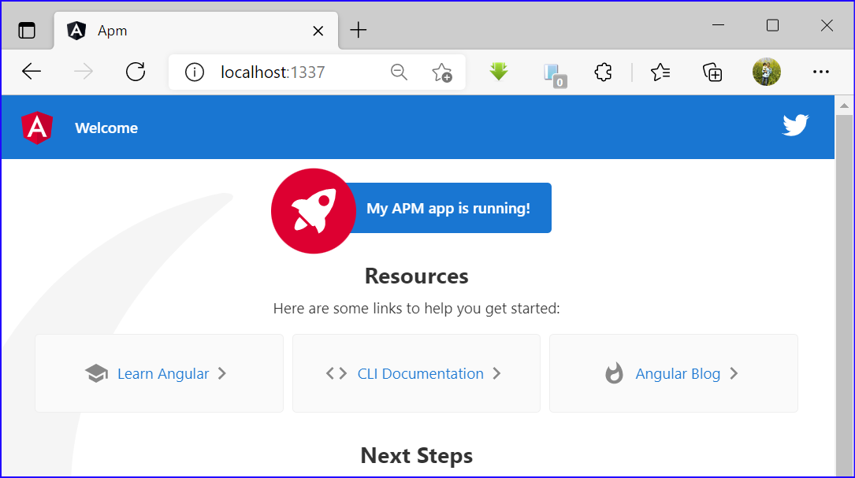
Demo: First Project
APM Project
1.1 Installing Angular
1.2 Create Application
1.3 Running the Project
1.3.1 On Default Port
1.3.2 Specified Port
1.3.3 Change Detection

Slide 6
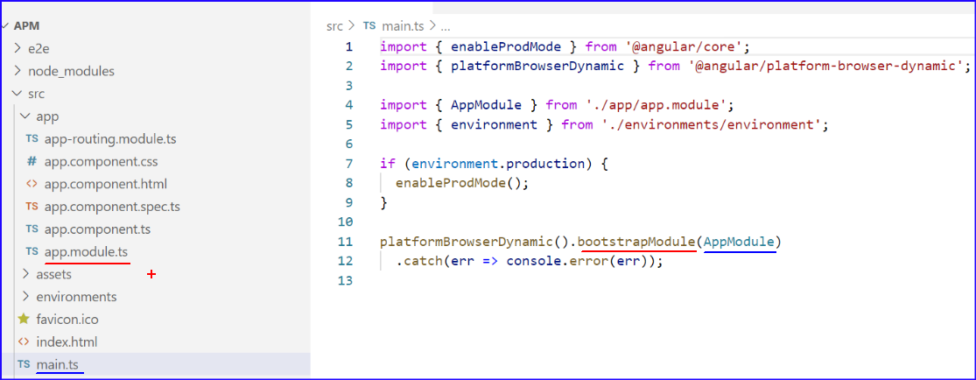
How ANGULAR Triggers index.html
The code in main.ts file is the first code which gets executed. The job of main.ts is to bootstrap the application. It loads everything and controls the startup of the application.
AppModule refers to the app.module.ts file.
Notes:
The first part of the statement platformBrowserDynamic() creates a platform. Angular docs describe the platform as: the entry point for Angular on a web page. Each page has exactly one platform, and services (such as reflection) which are common to every Angular application running on the page are bound in its scope.

Slide 7
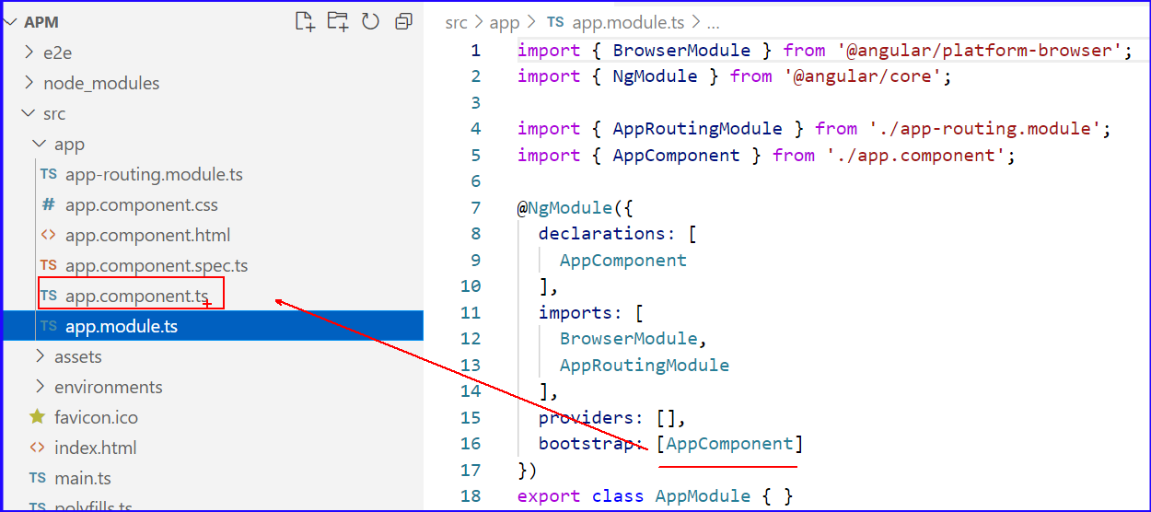
Application Workflow
The most important part from a file, when angular starts, is bootstrap array in @NgModule

Slide 8
Application Workflow
The bootstrapping process creates the component(s) listed in the bootstrap array and inserts each one into the browser DOM.
While you can put more than one component tree on a host web page, most applications have only one component tree and bootstrap a single root component.

Slide 9
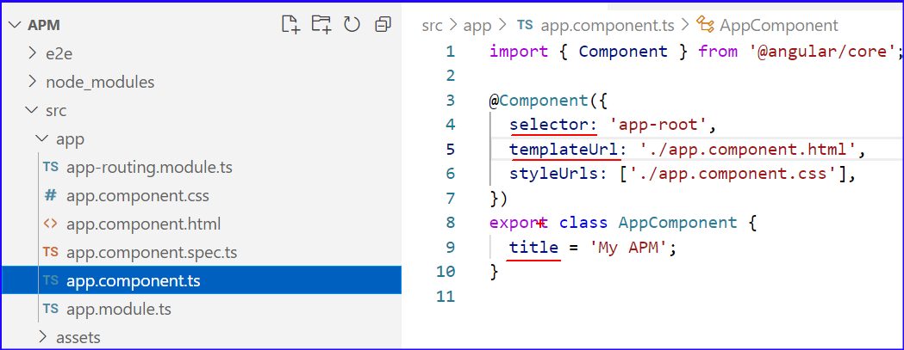
Application Workflow
By default, angular does not scan all of our files. So, if we don't tell it that the new component exists, angular doesn't know it.
In the component, you specify the selector and the template that will be rendered when this selector is used in DOM.

Slide 10
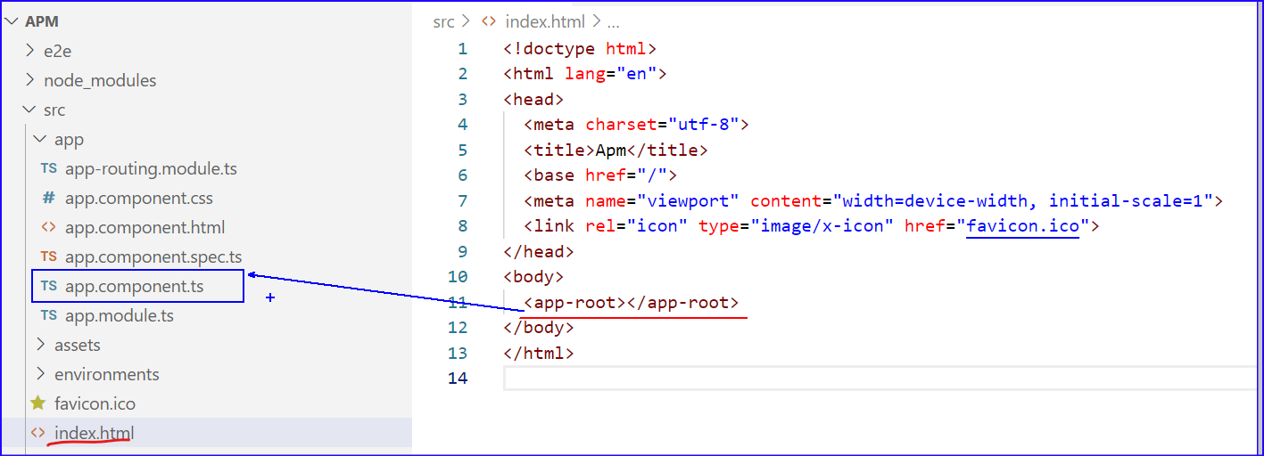
Application Workflow
So, when the selector as mentioned in the registered component is invoked the corresponding template is rendered.

Slide 11
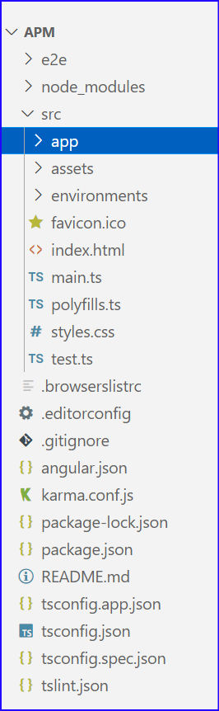
Application Structure
The structure that we have is as follows
Folder-name | Description
E2e | This is the folder where source code end to end test is listed
node-modules | This folder contains the third party libraries that our application may depend upon
src | This contains the actual source code of the application

Slide 12
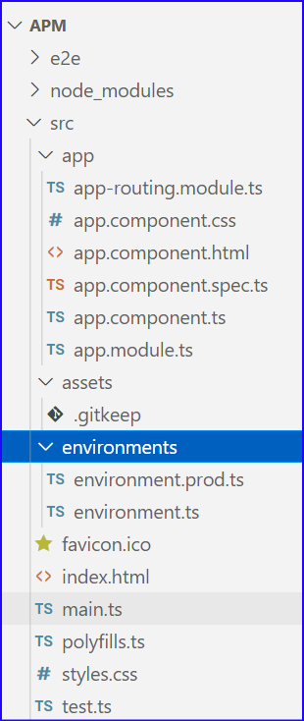
Application Structure
The structure of src folder that we have is as follows
Folder-name | Description
app | Every App folder has atleast one app module and one app component
Assets | Any images /icons of application
Environment | Settings for different environments
favicon | Icon displayed in browser
index.html | A simple html page that contains angular application. It doesn’t have any references to css or libraries, which get dynamically inserted
main.ts | It is starting type of application. It is similar to other apps, where main method is starting point. It just bootstraps AppModule. And Angular loads this module, and everything starts from there.

Slide 13
Application Structure
The structure of src folder that we have is as follows
Folder-name | Description
polyfills.ts | Scripts for running angular. Many browsers don’t have all features that are required for running angular. This typescript fills that gap
styles.css | Global styles for application
test.ts | For setting up our testing environment

Slide 14
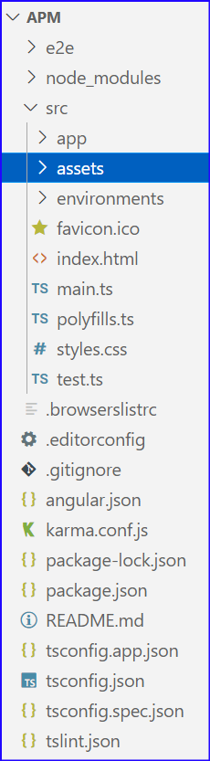
Application Structure
The structure that we have is as follows
Folder-name | Description
.editorconfig | It consists of a file format for defining coding styles and a collection of text editor plugins that enable editors to read the file format and adhere to defined styles.
.gitignore | to maintain untracked files which will be useful during git commit process to ignore the files.
angular.json | provides workspace-wide and project-specific configuration defaults for build and development tools provided by the Angular CLI.
browserslist | This file is used by the build system to adjust CSS and JS output to support the browsers specified in this file.
karma.conf.js | Storing settings for Karma, a javascript test runner

Slide 15
Application Structure
The structure that we have is as follows
Folder-name | Description
package.json | This package. json includes things like Name of application A set of packages, some of which are required by Angular and others that support common application scenarios. If you find that you don’t use the package, you may delete that devDependencies section listing packages required for development of application.
tsconfig.json | Typescript settings for typescript compiler. Based on these settings it will compile the typescript code to javascript.
tsconfig.app.json | This file contains options and flags that are essential for Angular applications. It is used by TS Compiler for checking location where ts files of project exist

Slide 16
Application Structure
The structure that we have is as follows
Folder-name | Description
tsconfig.spec.json | This file contains test environment specific settings
tslint.json | tslint is a static code analysis tool used in software development for checking Typescript code quality , if TypeScript source code complies with coding rules. TSLint checks your TypeScript code for readability, maintainability, and functionality errors

Slide 17
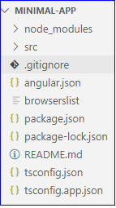
Application Structure
We can even generate an application with minimal code (this will exclude test env)
ng new --minimal=true --skipTests=true minimal-app

Slide 18

Single Page Application
Most angular applications have a landing page, called index.html
This is often the only web page of the application
Hence application is often called Single Page Application (SPA)

Slide 19
Angular App
Every angular app, has one component that we call as App component or root component
App
Navbar
Courses
Sidebar
Course
A real world application is a tree of components starting from root component.
And there may be many other components being used in other components

Slide 20
Angular Component
A component encapsulates the following
Data
HTML Template
Logic
This is what the user actually sees
In an angular app, we have at-least one or more component. Rather, we will have a lot of components

Slide 21
Components
Let’s say we are building a website, where-in structure is as follows
Navbar
Sidebar
Courses

Slide 22
Components
We can create a single AppComponent, or break this into separate maintainable and potentially reusable components
Navbar
{ }
Sidebar
Courses
{ }
{ }

Slide 23
Components
Or even Courses component in to still smaller components
Navbar
{ }
Sidebar
Course
{ }
{ }
Course
{ }
Course
{ }
Course
{ }

Slide 24

Import statement
Before we use any external function or class , we need to tell angular where to find it
Import allows us to use members from third party library, own ES modules or from Angular
When we need something we import it from Angular library
@Angular/
core
@Angular/
http
@Angular/
animate
@Angular/
route

Slide 25
Angular Module
A module is a container for group of related components
Every angular app has at-least one module, which we call App module
As the application grows, you may want to break modules into smaller more manageable modules

Slide 26
Angular Modules
So, we may have some modules in our application
Courses
Instructor
Admin
Courses module, which includes bunch of components for displaying courses
Instructor module, which includes bunch of components for instructor dashboard
Admin module, which includes bunch of components for managing the users and other configuration
The bigger the application, more will be components and so will be modules

Slide 27
Angular Module Structure
Import statement
Every angular app has at-least one module, which we call App module
As the application grows, you may want to break modules into smaller more manageable modules

Slide 28
Using a Component
There are 3 steps you need to follow to use a component
1. Create Component
2. Register it in a module
3. Add an element in HTML Markup

Slide 29
Angular Component
An Angular component includes a template, which lays out the user interface fragment defining a view for the application.
Class
Component
Template
Properties
Metadata
Methods
Extra data for Angular
Defined with decorator.
For example @Component decorator

Slide 30
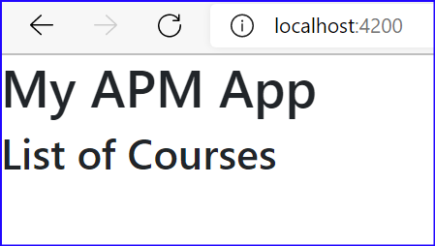
Demo: Component
1 Creating A Component
1.1 Creating A Component Using VS Code
1.1.1 Creating Component
1.1.2 Registering Component
1.1.3 Adding The selector in html page
1.1.4 Running the Application
1.2 Creating A Component via CLI

Slide 31
Template
The metadata for a component associates a template with the component, either directly with inline code, or by reference.
Together, the component and its template describe a view.
Template property can have inline html block or can reference html

Slide 32
Directives
Directives are classes that add additional behavior to elements in your Angular applications.
Angular Directives are dynamic. When angular renders them it transforms the DOM according to the instructions given by directive
html
Directive
Manipulates
head
body
title
h1
p

Slide 33
Types of Directives
Components
Directives with templates.
[For example, selector in a component can be added in another component]
Adds or removes DOM elements in DOM Layout
[For example ngIf, ngFor, ngSwitch]
Structural Directives
Changes appearance of an element
[For example ngStyle, ngClass, ngModel]
Attribute Directives

Slide 34
Built in Structural Directives
ngIf directive is available with BrowserModule and AppModule imports BrowserModule
Thereby AppComponent and other components registered with AppModule can use ngIf or ngFor directive
BrowserModule
AppModule
AppComponent

Slide 35
Built in Structural Directives
* is used before these directives to indicate it as shorthand to explicitly defining the data bindings on a template tag.
Structural Directives
Add or remove DOM elements in DOM Layout
ngFor
ngIf
ngSwitch
Repeater directive that iterates over collection of data
Adds or removes element from DOM
Displays one element out of multiple elements based on condition

Slide 36
Built in Structural Directives
*is added before ngIf or ngFor or ngSwitch.
The asterisk is "syntactic sugar". It simplifies ngIf and ngFor for both the writer and the reader. Under the hood, Angular replaces the asterisk version with a more verbose form.
The next two ngIf examples are effectively the same and we may write in either style:
<!-- Examples (A) and (B) are the same -->
<!-- (A) *ngIf paragraph -->
<p *ngIf="condition">Our heroes are true!</p>
<!-- (B) [ngIf] with template -->
<template [ngIf]="condition">
<p>Our heroes are true!</p>
</template>

Slide 37
Built in Attribute Directives
Attribute Directives
Changes the appearance or behavior of an element
ngStyle
ngClass
ngModel
Sets inline styles dynamically based on state of component
Adds or removes css classes dynamically
Displays a data property and updates it as per the user interaction

Slide 38
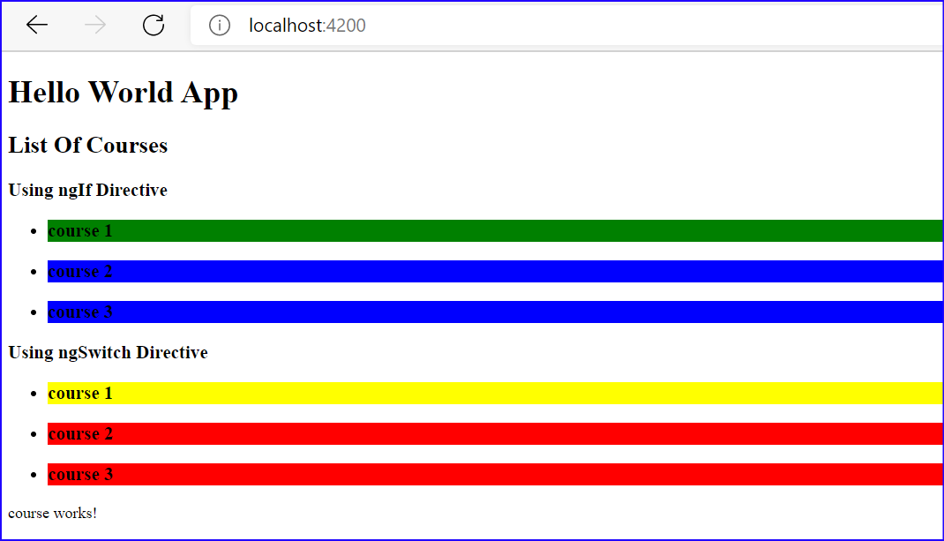
Demo: Templates and Directives
1 Templates and Directives
1.1 Template
1.2 Directives
1.2.1 Using ngFor directive
1.2.2 Using ngIf and ngStyle
1.2.3 Using ngSwitch Directive
1.3 Getting Data In Real World

Slide 39
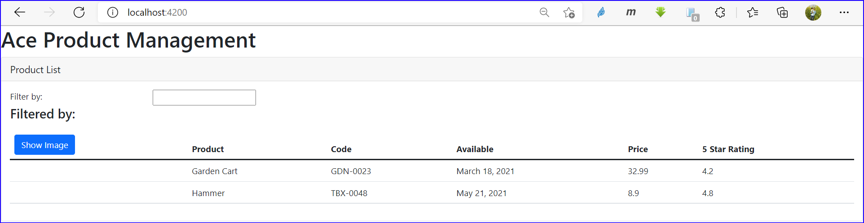
Demo: Using For Directive
Let’s create another component to display Products

Slide 40
Services
A service is typically a class with a narrow, well-defined purpose.
It encompasses any value, function, or feature that an app needs.
An example of when to use services would be to transfer data from source to the component .

Slide 41
Dependency Injection
Dependency Injection (DI) is a core concept of Angular 2+ and allows a class receive dependencies from another class.
Most of the time in Angular, dependency injection is done by injecting a service class into a component or module class.

Slide 42
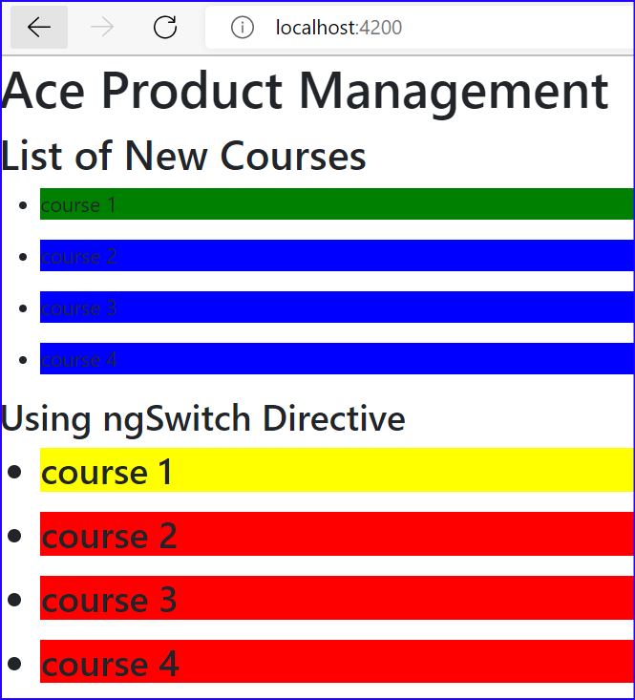
Demo: Services and Dependency Injection
1 Services and Dependency Injection
1.1 Service
1.2 Dependency Injection
1.2.1 Registering the Provider in app.module.ts
1.2.2 Registering the Provider in courses.component.ts

Slide 43
THANK YOU!

